Slide 1


Quality transitions from trade to teacher: challenges for policy and practice
Bill Blayney and Bobby Harreveld

Slide 2
Where we’re going …
1. Evidence based practice
A case study: trade to teacher (1999-2013)
2. Practice-informed Policy
3. Policy-Practice nexus

Slide 3
A case of career transitions
From
Trade
To
Teacher
10 years later
4 year Bachelor degree
Credit trade knowledge & experience
Teacher registration
N=16

Slide 4
1. Why chose to transition to teaching?
Disillusionment
I go to work at 6 and I get home at 6 and tow a trailer full of tools and build massive houses and there was something missing
Family
You only see your kids grow up once; you don't get a second dig at that kind of thing; you can't go back and try again later.
Envision
Could be a teacher: 12/16 Certificate IV Workplace Training & Assessment
Age crisis
I set myself a goal. I knew I had to do it. I knew if I didn't do it by the time I was 40, I would have missed the boat.
Chance encounters
“You know mate you should be a teacher”
Unique
Lived
Experiences
Combinations
Combinations

Slide 5
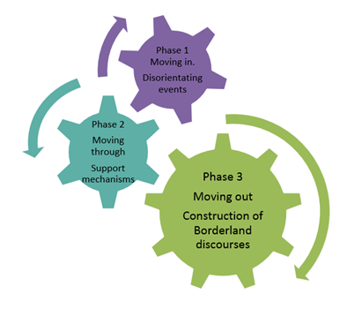
2. How do they manage that transition process?
Crack the codes
Use street cred
Fuse school & real world

Slide 6


Trade to Student
Backpack for “moving in”
& “moving through” university
- distance & f2f residentials
- earn & learn options
- language & literacy inclusive
- built-in personal touch via coordinator

Slide 7
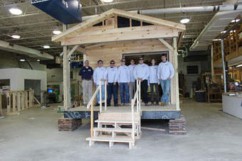

Student to Teacher
Backpack for “moving out” into schools
- reduced teaching load
- customised induction: school & department policy & procedures, protocols, expectations
- PD opportunities: unpacking curriculum & design, classroom management practices

Slide 8
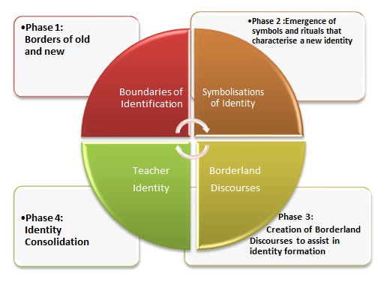
The Hybrid Teacher: both … and …

Slide 9

So what for …
Policy
2007 Supply & Demand crisis
(Queensland Government)
Response:
Scholarships to current secondary and primary teacher workforce who may have been interested in retraining as Industrial Technology & Design and Home Economics/Hospitality teachers (DETA, 2007)
Fast track incentives upon completion e.g. accelerated progression pay scales
Scholarships to trades persons to enter pre-service teacher education degrees
2011 failure to recruit tradespersons in sufficient numbers into initial Secondary teacher education programs (Australian Government)

Slide 10
So what happened?
[by end of case study research]
2013 Teacher shortages
(Queensland Government, DETA 2007 & 2013; Australian Government 2011)
- Resources sector offering significantly higher wages than teaching
- Older teachers retiring & continuing to do so
Continued difficulty: recruitment & retention of trade based teachers particularly in regional areas
2011 failure to recruit tradespersons in sufficient numbers into initial Secondary teacher education programs (Australian Government)

Slide 11
Significance of findings?
2017 Teacher shortages: Critical
- Older teachers retiring & continuing to do so
- Low recruitment technically knowledgeable & workplace experienced practitioners into teaching
- Lack of jurisdictional cohesiveness in policy & practice responses
2011 failure to recruit tradespersons in sufficient numbers into initial Secondary teacher education programs (Australian Government)

Slide 12

What to do?
Drive future integrated policy & practice
Strategic principle: Build in [do not bolt on]
Getting IN – to teacher education course
Getting THROUGH – off-the-job & on-the-job
Getting ON – in the profession

Slide 13
How to do it?
National Taskforce
Education Employers + Industries/Firms + Universities + VET & Teaching standards agencies
Getting IN
Credit e.g. Cert IV T&A + Trade Quals [relevant] & Work [recent & relevant]
Customised career preparation [incl. non-academic entry requirements]
Getting THROUGH
Earn & Learn: scholarships/cadetships
Enabling: language & literacy; personal contact
Blended delivery: online, supported distance, f2f discipline workshops
Getting ON
Accelerated progression pay scales for graduates
In-school Mentoring & PD [curriculum & behaviour management]

Slide 14
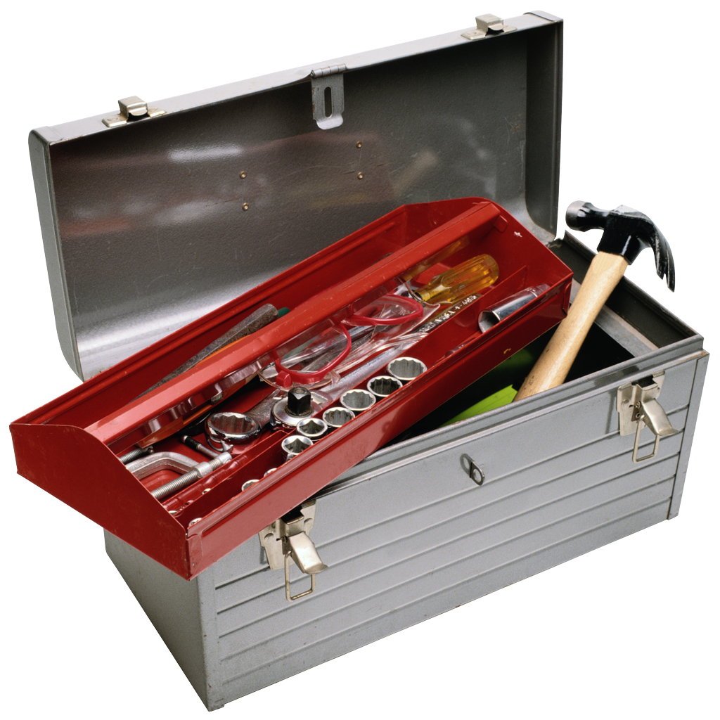

Conclusion in their words …
I know what makes you tick because that was me
I am going to help you
I am going to look after you to the best of my ability
I understand what makes you different and why you feel that way
I understand why some of you feel you don’t fit in because I also didn’t fit in

