Slide 1
A personal view of the growing importance of teacher training in VET
Robin Shreeve
Former CEO of Skills Australia, TAFE Western Sydney / OTEN, City of Westminster College, TAFE NSW North Coast institute
Keynote address, ACDEVEG 2017 conference
Notes:
Teacher training part of revitalisation – TAFE will need to recruit lots of new teachers if it is to expand as well as replace those left/retiring
ASQA report on TAFE SA – revealed some teachers inadequate knowledge of assessment, teaching and learning
Personal view – based on my experience

Slide 2
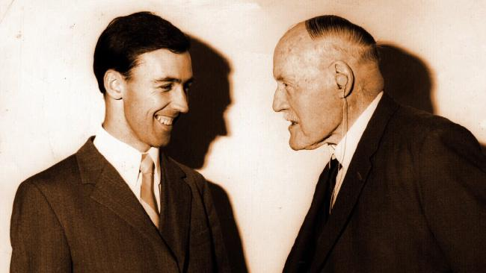
Jack Lang, quoted by Paul Keating
In the race of life, always back self-interest; at least you know it's trying.
Notes:
Growing importance – preaching to the choir
Self interest exist in lots of areas
Objectivity

Slide 3

Calls for the revitalisation of VET, especially TAFE

Slide 4
As a result of
Funding cuts (documented by Peter Noonan and Gerald Burke)
VET Fee Help debacle
Marketization (good or bad - depending on your political view point)
Cannibalisation by the University Sector
Fears of skill shortages in VET trained occupations
Notes:
Bit sceptical – shortage of cooks hairdressers – we train a lot – retention issue
Rent seeking
Cavin Moddie quote

Slide 5
Remedy emphasis on:
Better funding
Revisions to competition policy
Improving position and status of VET in the Tertiary Education Landscape
Reviewing and improving connections with industry
Revising Training Packages and curriculum – less on specific occupational competencies more on generic vocational and transferable skills and capabilities
Increasing use of new technologies – digital, online, virtual and augmented reality
Restructuring governance and structural arrangements

Slide 6
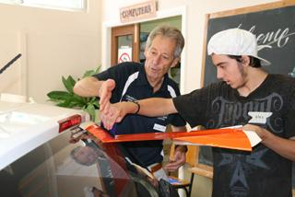
Not enough emphasis on revitalising VET workforce
Age profile
Retention
Education and training
Workforce development

Slide 7
Productivity Commission – VET workforce age statistics

Slide 8
Productivity Commission – TAFE workforce age statistics
Notes:
Productivity Commission
Age not issue – attract older workers
They are not intending to retire
Do not agree – diversity in age ranges

Slide 9
NSW Auditor General, Performance Audit 2008 – Ageing Workforce Teachers

Slide 11
Notes:
Very casual

Slide 13
TAFE NSW has lost 38% of its FTE teachers in 4 years
Notes:
Lost a lot of teachers
If expansion recruitment

Slide 14
Current VET especially TAFE teaching and assessing workforce
Older than most comparable workforces – lot of people in 50s, 60s and older
More casual
Been around longer
Not intending to retire
Getting smaller (TAFE NSW lost over 4,000 teachers in last 5 years)

Slide 15
Scenario One
Electrical trade section
Construction boom in Western Sydney results in record enrolments
Capacity constrained by shortage of teachers
I can get electricians off the tools to show the students how to pull cable through a wall
I cannot get teachers who can teach the students how to do trade qualifications including quadratic equations
My students are very mixed ability in maths - so we stream them
Notes:
Teaching very segmented in TAFE
Responding to different situations
Different issues
MD around Mount Druitt
Good teaching skills – and probably more PD than a cert 4 TAE

Slide 16
Scenario Two
Barangaroo Skills Exchange (BSX)
Pop up campus on large building site
Deliver support for apprentices, foundation skills and licensing courses in areas like dogging and rigging, working in confined spaces etc
“Best of breed” philosophy in staff utilisation
Using established full time TAFE teachers problematic – committed to apprenticeship programs and often lack recent workplace experience
So extensive use of external contractors who have very recent workplace experience
Notes:
Big g

Slide 17
Scenario Three
Growth of delivery of higher education qualifications by TAFE and VET institutions
40% of the population aged 25-34 has a degree
Few TAFE staff have doctorates and some that do are not research active (more have masters’)
Resistance to mandating even Bachelor degrees in TAFE – unlike school sector and most comparable professional occupations like nursing

Slide 18

City of Westminster College
30% of teaching staff aged under 35
Less than 10% of staff aged 55 plus
Because of superannuation / pension system unusual for staff to work beyond 60, very rare beyond 65

Slide 19
Three entry and initial training routes in my first FE College
Part time casual contract - industry qualifications and experience – recruited locally often completed part time teaching qualification such as City and Guilds 730 Further Education Teaching pre-service
Full time permanent – industry experience and qualifications but often with no teaching qualifications. Sent to Huddersfield Polytechnic to do PGCE on block release in-service.
Full time permanent – industry experience and degree. Undertook PGCE at own expense pre-service.
Notes:
Routes varied by discipline
Liberal studies
Trades students have a bit more rounded education
Liberal studies – letter and report writing, citizenship
Most famous – Tom sharpe

Slide 20

Tom Sharpe, Cambridgeshire College of Arts and Technology
The man who said the pen was mightier than the sword ought to have tried reading The Mill on the Floss to Motor Mechanics. (Wilt, 1976)

Slide 21
English FE and Skills Teaching Qualifications
Recent
Current
Preparing to teach in the Lifelong Learning Sector (PTLLS) – QCF Level 3
Certificate in Teaching in the Lifelong Learning Sector (CTLLS) – QCF Level 4
Diploma in Teaching in the Lifelong Learning Sector (DTLLS) – QCF Level 5 – QTLS status
Post Graduate Certificate in Education (PGCE) – Further Education – QCF Level 6/7 – QTLS Status
Award in Education and Training – QCF Level 3
Certificate in Education and Training – QCF Level 4 – must be in teaching role
Diploma in Education and Training – QCF Level 4 –QTLS Status
Post Graduate Certificate in Education (PGCE) – Further Education – QCF Level 6/7 – QTLS Status

Slide 22


Slide 23
“New blood recruitment”
Should casual teaching be the main route to a full time job?
Do we tend to clone ourselves?
Is there resistance to staff aged under 30?
Do we need a VET / TAFE version of “Teach First” or “Teach for Australia”
WorldSkills winners?

Slide 24
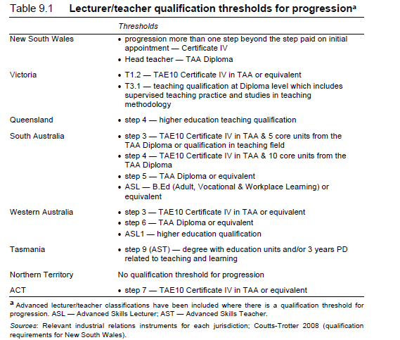

Slide 25
Teacher capability frameworks

Slide 26
Notes:
UK
Learning support assistants
Technicians acting as demonstrators
But still need a teacher

Slide 27
Teaching, learning and assessment in further education and skills – what works and why (OFSTED, 2014)
Teachers (who) understand the purpose, and are very flexible in their use, of a particularly wide range of teaching strategies and approaches that very successfully enhance all learners’ development, regardless of their ability levels. They base these strategies and their approach on developing learners’ essential skills and knowledge in subjects and vocational specialisms as well as the wider range of skills needed for progression and employment. They adapt these quickly and effectively according to learners’ progress

Slide 28
TAFE teaching staff
In my experience most very professional and committed to their students
Should be well-paid
Existing contract in states like NSW problematic – 4 weeks leave, 7 weeks agreed non-attendance and 4 days per week on campus attendance for other 41 weeks
Existing teachers value and committed to this contract
This contract has encouraged management to casualise – though AEU would say management have failed to use existing contract effectively
Maybe a barrier to large scale government investment in new workforce
Notes:
One potential barrier
Teacher contract
AEU argue flexible – management failure
Myth teachers have 10 weeks leave – attend 4 days per week

Slide 29
What is to be done?
Peak bodies to advocate for major teaching workforce renewal strategy for VET, especially TAFE
Come to an accommodation with the teachers unions about a new teacher contract, especially in TAFE
Consider a “new blood” recruitment strategy for people with relevant industry experience to have pre-service teacher training at PGCE level

Slide 30


