Slide 1

What a difference a qual makes: Pedagogical and vocational qualifications for VET teachers
Erica Smith & Jackie Tuck
ACDEVEG conference December 2017, Brisbane

Slide 2

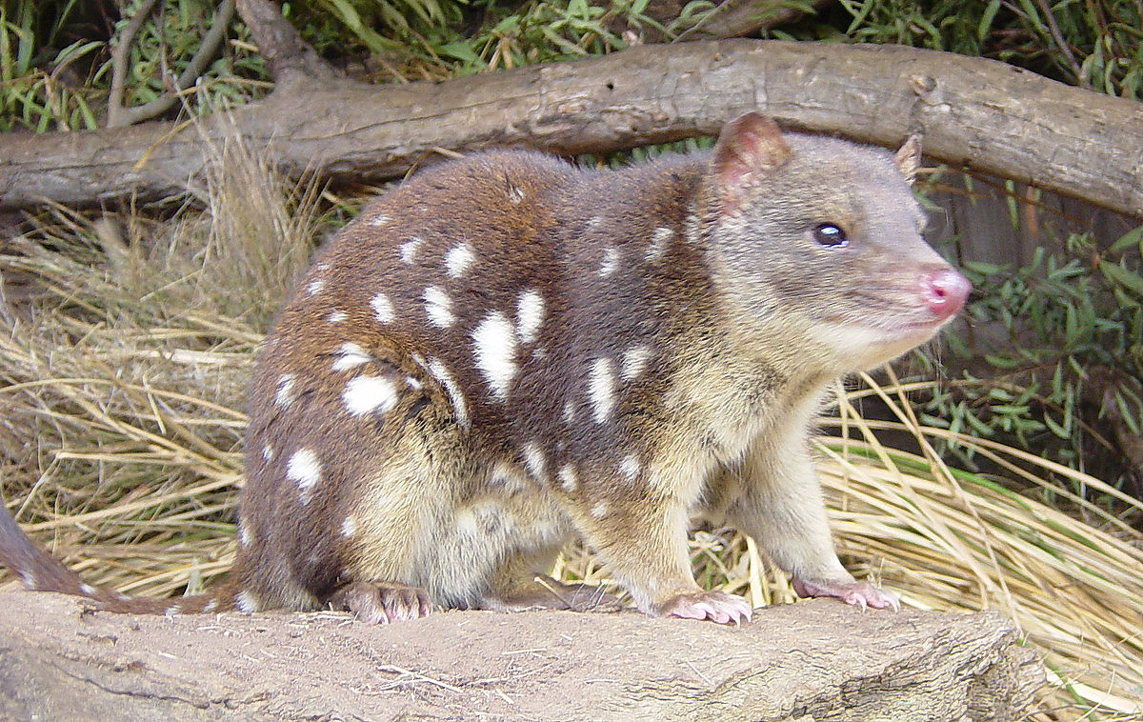
No, not that sort of quoll!

Slide 3
The project Would more highly qualified teachers and trainers help to address quality problems in the Australian VET system?
2015-2017
Research team: Erica Smith (Fed Uni School of Education), Keiko Yasukawa (UTS), Roger Harris (UniSA), Jackie Tuck (Fed Uni Business School).
Funded by the Australian Research Council Linkage program with Partner Organisations:
VET Development Centre,
Australian Council for Private Education and Training,
National Centre for Vocational Education Research,
Federation Training,
TAFE Queensland.
Note: This project does not assume that teachers and teaching quality in VET are the main contributors to VET quality issues. Many other factors are involved (e.g. funding distortions) and our research took care to acknowledge this.

Slide 4


The wide variety of VET teaching contexts
Types of training provider
50 TAFE (Technical and Further Education) Institutes: the public system;
4000 private training providers;
Community colleges;
Secondary schools;
200 Enterprise providers -training and awarding qualifications to their own workers.

Slide 5
A short history of VET teacher qualifications
Prior to mid-1990s most full-time TAFE teachers undertook ‘in-service’ VET/adult education degrees.
Advent of the requirement for a Certificate IV level qualification in 1998; TAFE gradually stopped requiring degrees.
Private and community training providers (4600) –Registered Training Organisations (RTOs) don’t have any general requirement for VET-teaching qualifications.
Now, only about 1000 people undertake higher education quals in VET pedagogy voluntarily, at around 10 universities.
Representatives of these universities are members of the Australian Council of Deans of Education Vocational Education Group (ACDEVEG).

Slide 6
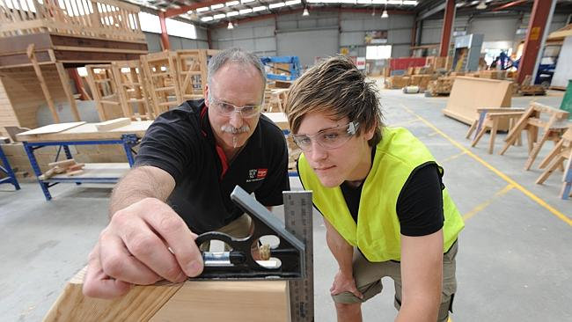

Research questions
What differences do VET teachers’ levels of qualification (pedagogical and discipline-based) make to their teaching concepts, approaches & practice?
What differences do VET teachers’ levels of qualification make to their ability to navigate complex training contexts, to teach a diversity of learners, and to achieve improved student outcomes?
How do levels of qualification affect VET teachers’ engagement in further professional development activities and how can PD be tailored for different groups?
How can more highly-qualified VET teachers contribute to improved quality in VET? What actual and potential barriers and facilitators are there?

Slide 7
Project method (in all States/Territories): Completed/still to do
2015 preliminary focus groups with teachers (5 groups), students (6 groups) and 11 stakeholder interviews: What makes a good VET teacher? (Reported 2015)
2015 Case studies in four TAFE and four non-TAFE RTOs.
2016 Survey to investigate differences in teacher attitudes and practices by level of teaching qualification – administered through 7 TAFE Institutes and c.40 private & enterprise RTOs. 574 responses. (Reported 2016)
2016 Analysis of professional development practices to see whether engagement is affected by level of qualification. In RTO case studies (six); and via survey through external PD provider.
‘Delphi’ exercise with two streams of stakeholders: policy people and senior TAFE/RTO managers; plus an international stream (So far, England and Scotland).
Final policy workshop with our reference group (including Commonwealth government) and Partner Organisations, December 19th
.

Slide 8
Numbers of individual people who participated in the research
Stage/Phase | Activity | No. of participants
Stage 1: Phase i | Stakeholder interviews | 11
 | 11 focus groups of teacher/trainers and students | Teachers: 29 Students: 40
Stage 1: Phase ii | National Teacher/Trainer Survey administered through eight TAFE and 48 non-TAFE RTOs | 574
Stage 1: Phase iii | Case studies at four TAFE and four non-TAFE RTOs | 128
Stage 2 | Professional Development Survey administered through three external professional development providers | 368
 | Professional development case studies at three TAFE and three non-TAFE RTOs | 50
Stage 3 | Delphi process (so far) | 55
Total |  | 1255

Slide 9
The findings about qualifications and teaching
Key Finding 1: Higher level qualifications in VET pedagogy improve teaching approaches, confidence and ability to address diversity in contexts, learners and AQF level of teaching.
Key Finding 2: VET teachers often have high level qualifications in their industry area or other disciplines and these too improve teaching approaches, confidence and ability to address diversity in contexts, learners and AQF level of teaching.
Key Finding 3: Higher level qualifications in VET pedagogy make a significant difference to VET teachers’ confidence in teaching a diversity of learners.
Key Finding 4: The key qualification level that makes a difference is a degree.
Note: We only have time to present selected data from the surveys. The Key Findings are based on case study and interview data as well. It should be noted that some non-TAFE RTOs were less convinced of the benefit of higher-level qualifications; and there were also variations among discipline areas. We haven’t yet analysed all the survey qualitative data.

Slide 10
How did we approach teaching quality in the Teacher Survey?
A series of quantitative and qualitative questions were based on five domains from the Queensland College of Teachers’ Professional Standards for Vocational Education and Training Practitioners
Know learners, their context and how they learn
Know the content and how it can be taught
Plan, design and deliver effective teaching/training experiences
Assess, provide feedback and report on learning
Engage with industry, colleagues, community, regulatory and professional bodies
Respondents rated on a scale of 1 to 5 for how important they thought each item was for VET teacher/trainers in general; and their personal level of confidence in that activity or knowledge area.

Slide 11
‘Attribution of importance’ and ‘Personal confidence’: Overall averages for the people in each of six combinations of qualification levels
As there were 23 items overall (3-6 items in each domain) , the maximum score possible for ‘importance’ and ‘confidence’ was 115.
Highest VET pedagogy qual Highest industry qualification | Cert. IV TAE |  | Diploma |  | Degree or above
 | Attribution of importance | Personal confidence | Attribution of importance | Personal confidence | Attribution of importance | Personal confidence
Certs. III, IV, Dip, Adv. Dip. | 103.02 | 94.96 | 101.86 | 95.14 | 104.24 | 100.15
Degree or above | 105.73 | 96.90 | 103.73 | 100.42 | 106.61 | 103.37

Slide 12
Statistically significant differences among teachers with different levels of highest qualification for each of the QCT domains
(✓ = increases significantly with qualification level)
 | Highest overall qualification |  | Highest VET pedagogy qualification |  | Highest industry qualification
 | Attribution of importance | Personal confidence | Attribution of importance | Personal confidence | Attribution of importance | Personal confidence
Domain 1: Know learners, context & how they learn. | – | ✓ | – | ✓ | ✓ | ✓
Domain 2: Know the con- tent & how it can be taught. | – | ✓ | – | ✓ | – | ✓
Domain 3: Plan, design & deliver effective teaching/ training experiences. | – | ✓ | ✓ | ✓ | ✓ | ✓
Domain 4: Assess, feedback & report on learning. | – | – | – | ✓ | ✓ | –
Domain 5: Engage with ind-ustry, colleagues, commun- ity, regulatory, prof. bodies. | – | ✓ | – | ✓ | ✓ | ✓

Slide 13
The findings about qualifications and professional development
Key Finding 5: Participation in both formal and informal PD, in both industry/discipline and VET teaching/training increases with higher qualifications, irrespective of the type of qualification.
Key Finding 6: VET teaching/training PD should be tailored for teachers with higher levels of VET pedagogy qualifications

Slide 14
Participation in industry/discipline P.D. (VET pedagogy PD next slide), last 12 months, ‘regularly or ‘sometimes’: Groups exceeding average attendance.
 | Average attendance % | By overall qual | By VET pedagogy qual | By industry qual
Formal Activities Industry/discipline conferences | 75.4
Short courses, seminars or workshops within the RTO | 72.9
Short courses, seminars or workshops outside the RTO | 78.1
Network of teachers/trainers | 73.9
Membership of employer/industry/ professional association | 67.7
Informal activities Email lists, blogs or similar | 89.1
Own reading | 95.8
Informal liaison with employers | 87.6
Key:
Degree
Degree, Diploma
Diploma, Degree
Diploma
Cert IV, Dip
Cert III, Cert IV

Slide 15
Participation in VET teaching/training P.D., last 12 months, ‘regularly or ‘sometimes’: Groups exceeding average attendance.
 | Average attendance % | By overall qual | By VET pedagogy qual | By industry qual
Formal Activities Conferences | 52.7
Short courses, seminars or workshops within the RTO | 71.6
Short courses, seminars or workshops outside the RTO | 61.7
Formally constituted community of practice | 37.6
Informal activities RTO electronic or non-electronic newsletters/noticeboards | 81.3
Email lists, blogs or similar | 77.1
Own reading | 85.8
Key:
Degree
Degree, Diploma
Diploma, Degree
Diploma
Cert IV, Dip
Cert III, Cert IV

Slide 16
Participation in 10 or more external PD events in the last 12 months by highest industry and highest VET pedagogy qual.

Slide 17
Does PD need tailoring to different qualification levels?
When asked to comment on a particular external PD event of their choice (with one of the three major providers of PD),
People with degrees in VET pedagogy were more likely to say it was at too low a level (20% compared with 11% of people with only a Cert IV TAE). But still 90% found the event valuable.
People with Masters were least likely to find the events valuable (but still 72% satisfaction).
The PD case studies did not provide conclusive evidence, and data kept by RTOs was not available for analysis by qualification level. Several managers and teachers said that higher qualifications increase self-confidence in attending PD events. There were differences by discipline area, which sometimes linked to qual levels. We have not yet analysed all the qualitative responses in the surveys.

Slide 18
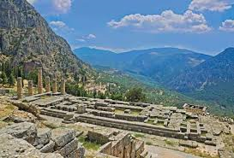
The Delphi process: Expert feedback
Named after the Oracle at Delphi in ancient Greece, it refers to consultation with experts. When used in research, it involves successive consultation with experts in the field.
… these days it means Survey Monkey!
Three-phase on-line survey to feed back results and explore implications.
1. Policy officials & other stakeholders (n=36)
2. Training provider managers (n=34)
Response rates: Round 1 - 73%; Round 2 - 57%; Round 3 likely to be just under 50%.

Slide 19
Findings from the Delphi process: 1
(Delphi 1 survey)
Stakeholders validated, from their own experience, the findings that higher level qualifications for VET teachers do make a difference to teaching quality.
Stakeholders report that the VET sector would find it more palatable to accept the beneficial effects of higher-level qualifications in teachers’ industry/discipline area than qualifications in VET pedagogy.
Some resistance is to be expected to any potential moves to increase requirements for qualification for VET teachers, especially to degree level.
Each of the project’s six Key Findings is likely to have some effect in the VET sector, with over half of respondents for each finding saying they would definitely or possibly take action as a result.

Slide 20
Findings from the Delphi process: 2
(Delphi 2 survey)
Over half of respondents thought that the minimum VET pedagogy qualification should be increased for VET teachers and trainers, especially for full-timers and existing staff.
VET pedagogy degrees and professional development (external and internal) are seen as the three best ways for VET teachers to develop specific VET teaching and assessment-related skills.
Respondents are looking for a national body to assist with teacher/trainer qualifications and professional development.

Slide 21
What is Delphi 3 about? (Closes this week)
Using the actions, issues and ideas put forward by respondents in Delphi 1 and Delphi 2 …
The most significant barriers to /facilitators for identified action on Key Findings;
More specific questions about appropriate qualifications for different groups of VET teacher (type of contract, new versus existing, etc);
Questions about each of the three VET pedagogy qualification levels (Cert IV, Dip VET and Degree);
Question about appropriate levels of industry/discipline level quals;
If a national body was established to oversee VET teachers quals and/or PD, what should its functions be?
What might be done with the results of this project?

Slide 22
Strong support from most Delphi participants – but also some opposition.
Opposition: Delphi survey comment from an RTO respondent:
I am very pleased that this research has been undertaken but would be horrified if significant changes to the VET ‘architecture’ were introduced as a result of such a limited study.
Email from a Delphi respondent who is CEO of a community college:
Sorry, I can't justify wasting any more time on such an irrelevant, self-referential piece of rubbish research. This is the very sort of thing that perpetuates the increasing irrelevance of VET to the real world. What a shame that "evidence based research" is just used to circulate among the same old self-interested and self-involved club. Another wasted public funded exercise in academic self justification. You should be ashamed of yourselves. Listen to INDUSTRY and COMMUNITY, not to the very VET operators who created the problem in the first place. But then again, the VET Research Club depends on the VET Practitioners Club to survive, so why would you want anything to change?

Slide 23
Supportive statements
From Delphi 3 policy respondents (‘Any further comments?’):
Great project. Findings should form the basis of future policy in relation to teaching/training and improving the quality of VET n Australia.
I applaud your efforts… No one seems to be driving VET forward currently.
Thank you for the opportunity to participate. I found the questions thought- provoking and they sometimes challenged my own perception of the VET teacher/trainer workforce.
The evolution of the findings has revealed the strengths and limitations of stakeholders’ perspectives.
And… The project should take an expansive, holistic view and locate the issue of qualifications in the wider context of VET reform.

Slide 24
For more information
Erica Smith e.smith@federation.edu.au
Research project web site
http://federation.edu.au/research-vet-quality
And a question for you: Would you, or colleagues, be interested in coming to a launch of the project findings? Let us know.

