Slide 1
Maintaining currency in VET
Overview
Background: Commentary on CPD
Introduction of Project: Industry release and Pedagogical expertise
Findings
Take home messages
Practitioner voices from a government training provider
Mark Tyler & Darryl Dymock
Griffith University

Slide 2
Background
Continuing Professional Development (CPD)- a means to build capability
No different in the VET sector
Dual professionals - current knowledge and skills in both educational expertise and industry practice.
“trainers and assessors undertake professional development in the fields of the knowledge and practice of vocational training, learning and assessment…” ( Standards for RTO, Clause 1.16)

Slide 3
Commentary on VET sector maintenance of dual currency through CPD
Most stakeholders agree that there is a need for CPD in maintaining dual currency
One off ad hoc – under evaluated
Difficulty in planning and catering for the wide diversity in the VET practitioner workforce
A national standards approach
Balancing responsibility for CPD, between employers and employees
A feasible model of CPD to deal with inadequacies in the minimum qualification

Slide 4
Method
Snap shot of a government training provider – research in progress
A larger project on CPD for VET practitioners – reported today: industry currency and pedagogical expertise
Research Question: How might VET teacher/trainers best maintain both sides of the duality in industry currency and pedagogical expertise?
Qualitative examination of lived experience of CPD
n=26; semi structured interviews across 4 campuses in SEQ

Slide 5
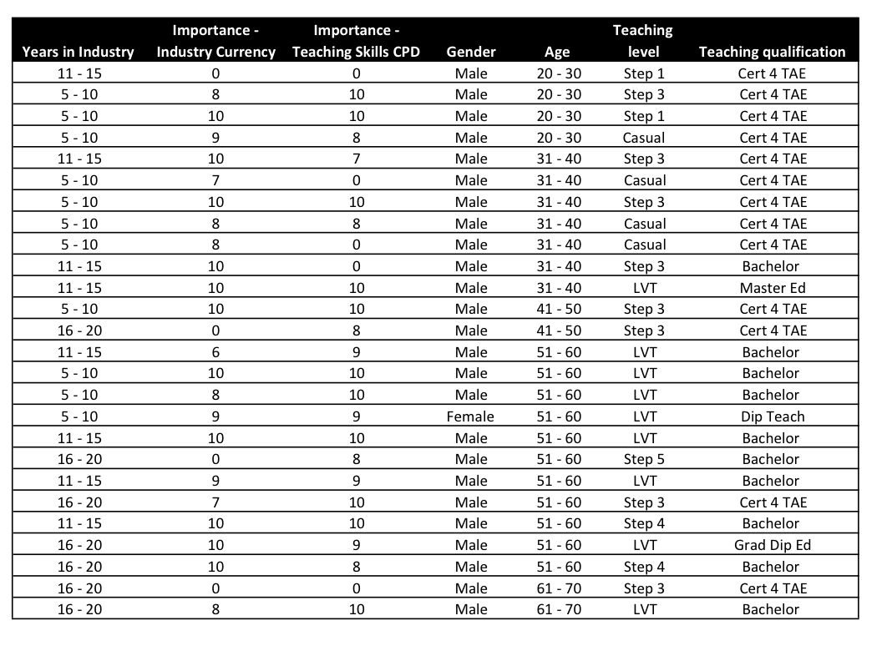
Demographics

Slide 6
Findings: Industry currency
All rated the importance of industry currency - 7 to 10, Half (13) rated it as a 10
On “why” it is so important – for example, “… teach the right thing” and “…know more than you teach”
’Industry release’
  13 in own or friends business or with past employer
  10 identified working in or visiting industry
  2 “kept current” through their teaching
  1 said, “too busy”

Slide 7
Findings: More on industry currency/release
Perceived effectiveness of Industry release
  Several acknowledged that time spent in IR did not necessarily result in new knowledge “‘any Tom, Dick or Harry’ could do the work they were doing in their week’s industry release” (Cecil)
  Younger VET teachers – “I always want to be able to share that “still-in-industry” feeling and experience…, and then I can bring it in here [classroom] and still be going, “This is how it is.”” (Pete)
Maintenance
  Generally, keeping up with some form of “practice”
  Augmented by: attending industry nights, researching online – journals and service manuals, membership of associations, problem solving in class, and tapping into peers knowledge and skill

Slide 8
Findings: Industry currency
Barriers
  Access, lack of financial support, frequency of OH&S updates, trust, and teaching demands.
What counts as IR?
  Ambiguous as there appears a plethora of acceptable activity and evidence

Slide 9
Continuing professional development of teaching knowledge and skill
Importance rating – all 7 to 10; 11 rated it as 10
Being a teacher and teaching appears as a highly influential motivator in prompting involvement in continuing professional development.
Main reported motivators – connected with being a quality trades person and Generativity
Roadblocks
  Change, family, and employer provision of CPD

Slide 10
Teacher perceptions of employer’s response to CPD
Events lack utility
High devotion to RPL updates in relation to Certificate IV TAE
Unsatisfactory levels of support for beginning teachers
General sentiment as expressed by Stan:“You are faced with the fact that within, … it's very difficult to get adequate training on things that you need. There's always things that you don't need. There's lots of EDL [education, development and learning] there that I think isn't worth doing. There should be things relevant to what we're doing as tradespeople”

Slide 11
Keeping “sharp”
Experienced teachers reported improving their teaching through, practice, self and peer reflection, and collaboration.
The less experienced teachers reported that it was only through them undertaking collaboration that they built new capacities in teaching.

Slide 12
Preliminary take home messages
CPD is alive within this government training provider
Maintaining industry currency and continuing to develop teaching knowledge and skills are congruent with these teacher’s motivations
What consists of, and counts as, industry release is variable and its effectiveness is unevaluated
The role of compliance in effecting the type and quality of CPD is unclear
Collaboration between teachers across years of experience in teaching and in industry is important for CPD
Beginning teacher preparation and support is reported as needing attention, and
These teachers called for the gathering and inclusion of their teacher voice in the type and content of CPD offered.

